Slide 1

WEB DEVELOPMENT: “SAMMILANI MAHAVIDYALAYA CHESS CLUB”
PROJECT REPORT PRESENTATION
Department of Computer Science
B.Sc. (Honours), SEMESTER: 6
Submitted By: Guided By:
Student Name: Oeyshik Das Supervisor: Prof. Brototi Mondal
Roll No: 193513-21-0023 (Associate Professor)
Reg. No:513-1111-0413-19

Slide 2
OUTLINES
What is “Sammilani Mahavidyalaya Chess Club”?
Project Requirements
Steps taken while making this project
Aim & Objectives
Modules
Project Preview
Conclusion & Future Work
References

Slide 3

What is “SMV CHESS CLUB” ?
“Sammilani Mahavidyalaya Chess Club” is a platform to make a community of people who loves chess.
In this website a chess enthusiast can finds all the information about chess in a single platform.
Any chess enthusiast can register as a member and participate in the events to promote chess culture.

Slide 4
Requirements
software requirements
Hardware requirements
HTML
CSS
JavaScript
Local Storage in Browser
Formspree
CPU: intel® CORE™ i3
RAM: 8 GB
Hard Disk Memory: 1 TB

Slide 5
Steps while making “SMV CHESS CLUB”
Information gathering
Planning
Design
Content Writing and Assemble
Coding
Testing & Review
Maintenance

Slide 6
AIM & Objectives
To make a fun community of chess loving peers.
To make a centralized source of information about chess.
To provide support information for any queries of a beginner who has just started to play chess.

Slide 7
Modules
RESOURCES
EVENTS GALLERY
FAQs
TESTIMONIALS
MEMBERS REGISTRATION FORM
CONTACT/FEEDBACK FORM
SOCIAL MEDIA LINKS
CHESS PERSONALITIES GALLERY

Slide 8
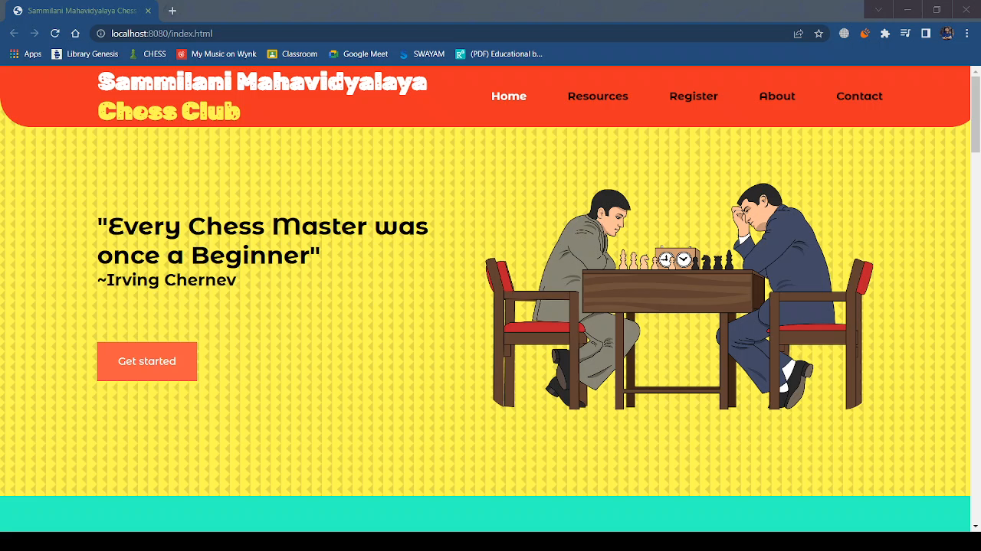
PROJECT PREVIEW

Slide 9
CONCLUSION & FUTURE WORK
“Chess playing makes kids smarter. ”- So we will learn and grow while having fun.
To make a dedicated chess playing platform where individuals can play among each other online.
Database of the games so that everyone can improve from their past games.

Slide 10
REFERENCES
[1] http://www.wikipedia.org
[2] https://unicons.iconscout.com/release/v4.0.0/css/line.css
[3] https://fonts.google.com/specimen/Montserrat
[4] https://fonts.google.com/specimen/Rubik+Moonrocks
[5] https://unpkg.com/swiper@8/swiper-bundle.min.css
[6] https://www.researchgate.net/
[7] https://creazilla.com
[8] https://formspree.io/
[9] https://en.chessbase.com/
[10] https://www.chess.com/

Slide 11
Slide Tite
THANK YOU

Slide 12

What questions would you like to ask me?

